Slide 1
Transit Accessibility

Slide 2
Agenda
Introductions
Overview of R at King County Metro
Two case studies:
Transit accessibility
Rider/Non-Rider Survey Analysis
Questions/Answers
Notes:
This may change. Planning to do introductions, frame the talk as one about why R/programming generally is useful in transit planning. Iteration, improvement, integration. Introduce case studies. Acknowledge that R is used on many other projects.

Slide 3
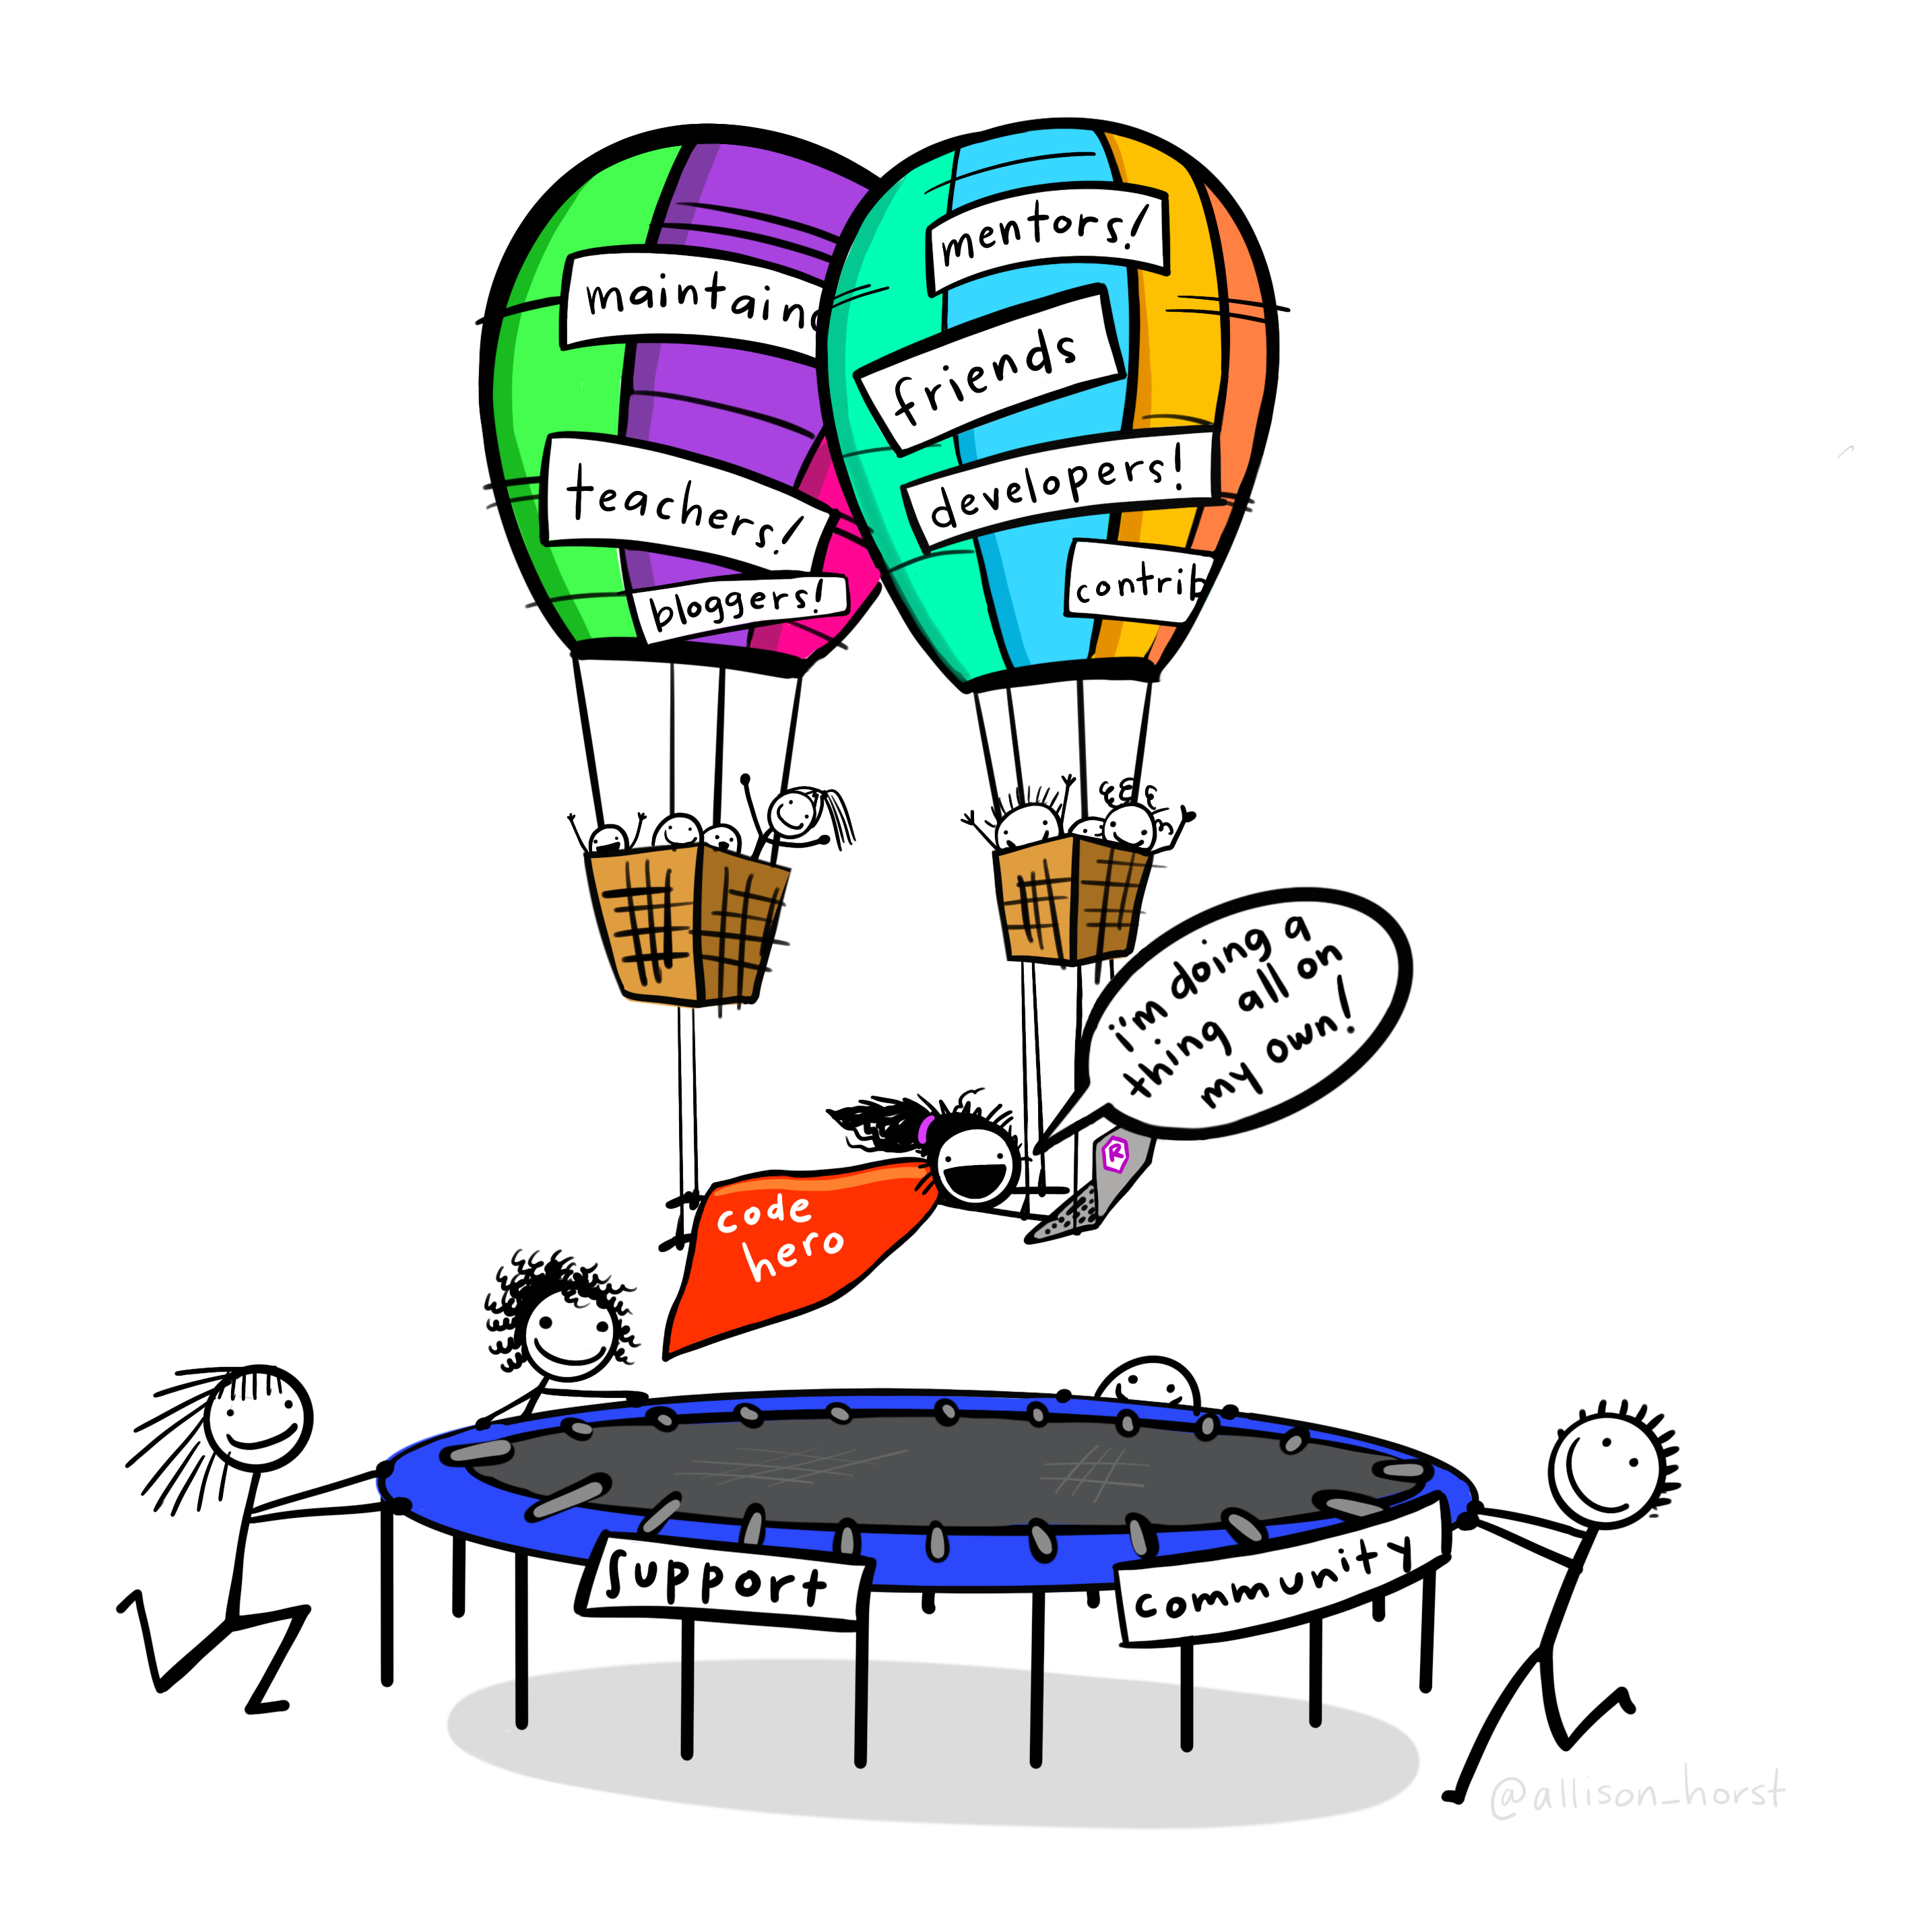
R at King County Metro
Au: Allison Horst
Notes:
Data science is evolving at KCM. We are building skills and internal support for rigorous analysis and the use of coding tools in our workflows. No one has a background in CS, so we take a “learn and teach on the job” approach to building a DS culture.

Slide 4
Transit Accessibility
Transit Accessibility: How many places someone can get to using transit in a certain amount of time from a their starting location.
Notes:
One of the many ways where we use R and our community of support is our accessibility analysis. Before diving in to how we do our analysis, I want to make sure that everyone knows what I mean when I’m talking about accessibility and why it’s an important part of transit planning.

Slide 5
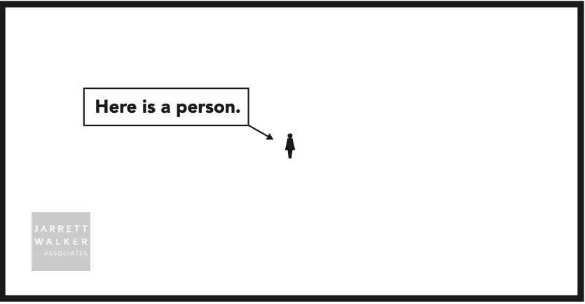
Transit Accessibility
Au: Jarrett Walker Associates

Slide 6
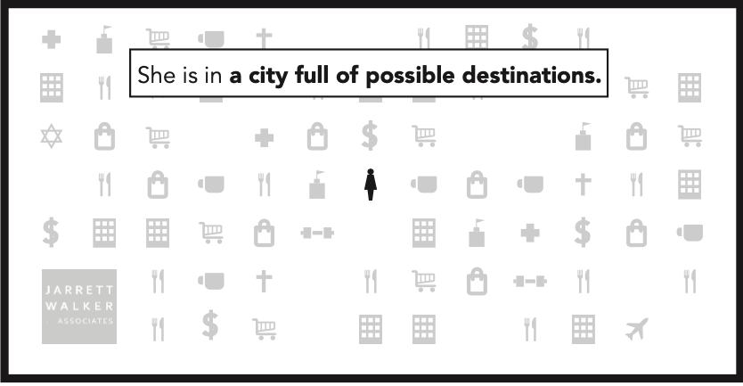
Transit Accessibility
Au: Jarrett Walker Associates

Slide 7
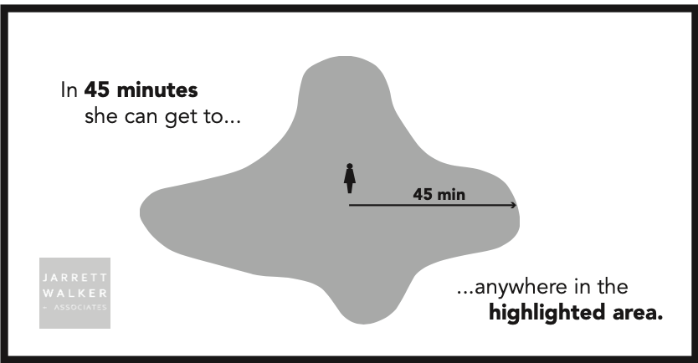
Transit Accessibility
Au: Jarrett Walker Associates

Slide 8
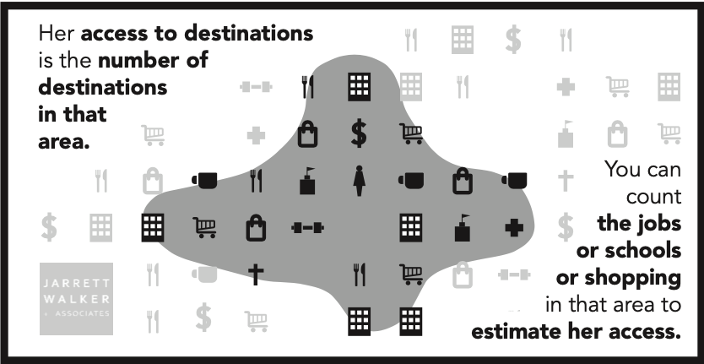
Transit Accessibility
Au: Jarrett Walker Associates
Notes:
Accessibility is important to measure because it can determine how much of a person’s travel needs can be completed on an existing or planned transit network. Metro’s strategic plan calls for annual measurements in the change in county-wide transit accessibility.
At a theoretical level, accessibility is very simple. However, the process of measuring transit accessibility requires iteration. This is where R plays a critical role, as traditional transit planning tools require planners to manually select analysis locations, which is not possible at a county-wide scale.

Slide 9
r5R to the Rescue!
r5R is a network based routing tool that allows analysts to model time-based travel for different modes of transportation.
Notes:
r5R is a network based routing tool that uses a java backend, the Open Street Map Network and the GTFS to allow analysts to model time-based travel for different modes of transportation. Allows for use of different decay functions ( a quick trip to a destination is worth more than a long trip).

Slide 10
A quick look at r5r
Requires:
Open Street Map network file
origin and destination points
General Transit Feed Specifications (GTFS)
Works well with the purrr library
Implements decay curves to model how people perceive opportunities (a quick trip to a destination is worth more than a long trip).
Full documentation available here

Slide 11
r5r at King County
Community Assets Database for destinations
First calculated using a quarter mile hexagon map, then aggregated using population weighted interpolation

Slide 12
Time for a demo!
https://king-county-metro.shinyapps.io/accessibility-demo/

Slide 13
r5r Accessibility Function
ttm <- accessibility(r5r_core = r5r_core, decay_function = "logistic", # origins = origins, destinations = dest_hex_points, # opportunities_colname = c("grocery", "public_spaces") , mode = c("WALK", "TRANSIT"), departure_datetime = as.POSIXct(departure_datetime, format = "%d-%m-%Y %H:%M:%S"), max_walk_time = 10, time_window = 5L, max_trip_duration = 45, verbose = F, decay_value = 15, cutoffs = 30)

Slide 14
Block Group Interpolation
interpolated_bg_access <- test %>% select(-rowid) %>% interpolate_pw(to = block_groups, to_id = "GEO_ID_GRP", weights = blocks, weight_column = "POP20", crs = 2926, extensive = FALSE, weight_placement = "surface")

